Slide 1
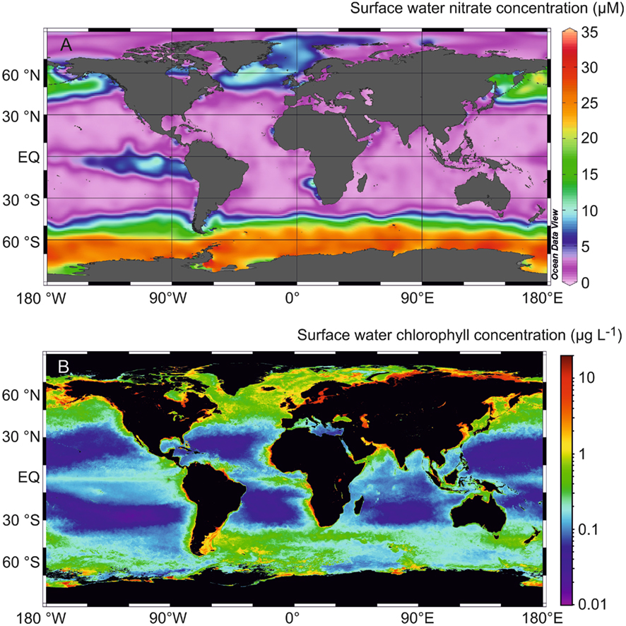
Nutrients and productivity III
1 June
2017

Slide 2
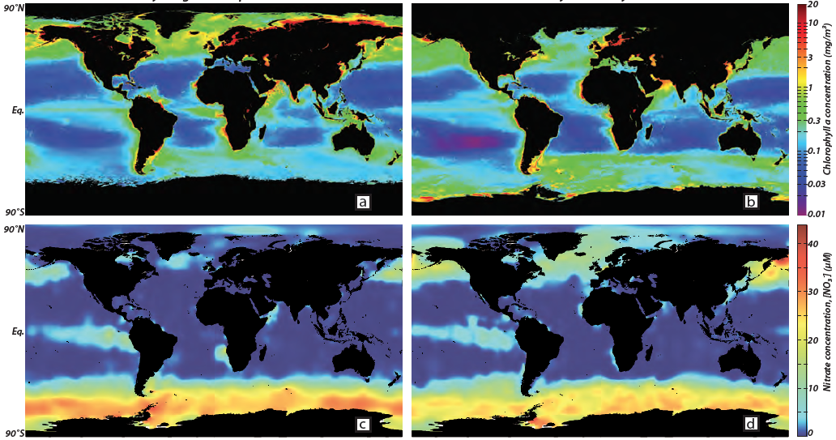
Internal cycle: N assimilation – NO₃⁻
Northern hemisphere summer
Southern hemisphere summer
Chlorophyll-a (mg/m³)
Chlorophyll-a (mg/m³)
[NO₃⁻] (μM)
[NO₃⁻] (μM)
oceancolor.gsfc.nasa.gov; www.nodc.noaa.gov; Sigman and Hain, 2012

Slide 3
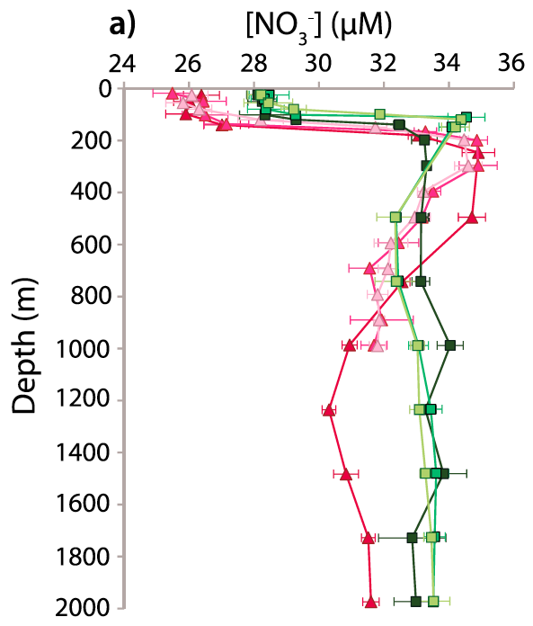
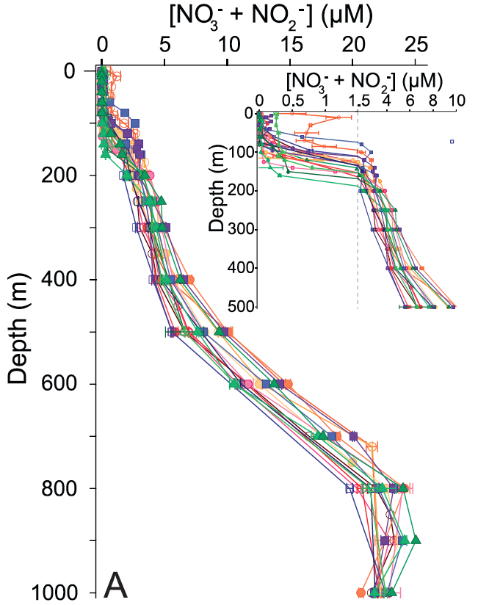
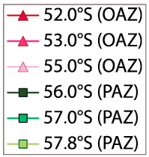
NO₃⁻ is the dominant form of bioavailable N
Atlantic Southern Ocean
Subtropical North Atlantic
Smart et al. 2015, Fawcett et al. 2015

Slide 4
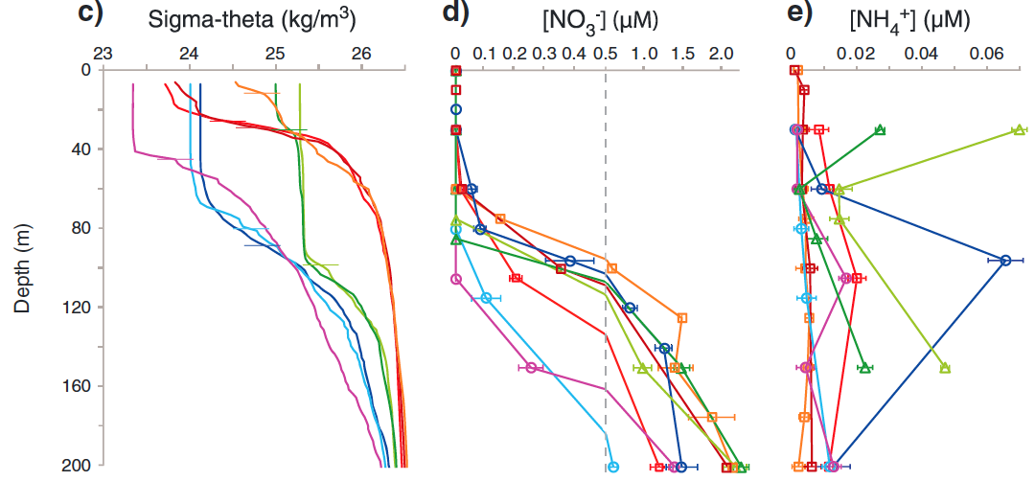
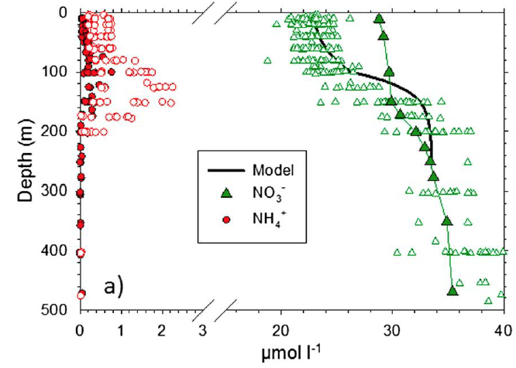
NH₄⁺: low concentration, high flux
Kerguelen Plateau
Southern Ocean
Subtropical North Atlantic
[NO₃⁻]
[NH₄⁺]
Fripiat et al, 2015, Fawcett et al. 2014

Slide 5
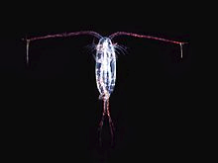
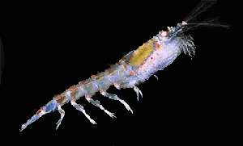
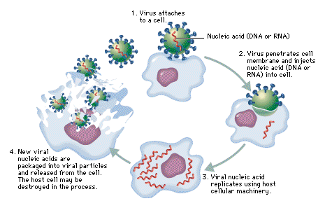
NH₄⁺: low concentration, high flux
Sources of NH₄⁺ to phytoplankton
particulate and dissolved organic N breakdown (ammonification)
grazing (zooplankton)
excretion (zooplankton)
sloppy feeding (zooplankton)
leaking cells
viral lysis
spontaneous cell death

Slide 6
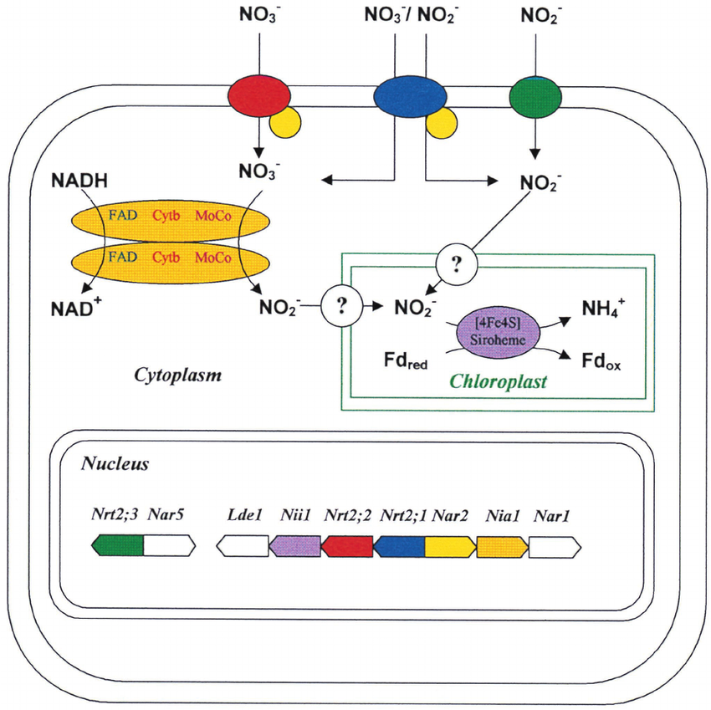
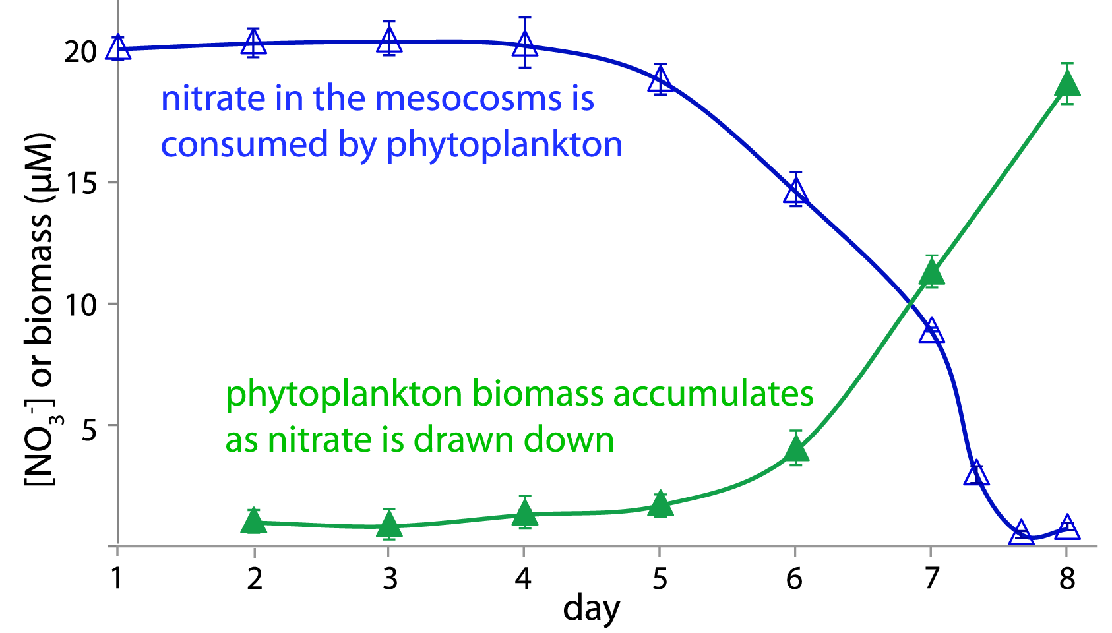
Internal cycle: N assimilation
NH₄⁺, NO₃⁻, NO₂⁻, dissolved organic N (DON) → N_{org}/PON
Phytoplankton require N (usually inorganic) for photosynthesis
NH₄⁺
Fawcett and Ward 2011; Moreno-Vivián et al. 1999

Slide 7
Internal cycle: N assimilation
55°S summer N uptake (nmol L⁻¹ d⁻¹)
55°S winter N uptake (nmol L⁻¹ d⁻¹)
NO₃⁻
NO₃⁻
NH₄⁺
NH₄⁺
euphotic zone depth
mixed layer depth
Mdutyana et al. in prep

Slide 8
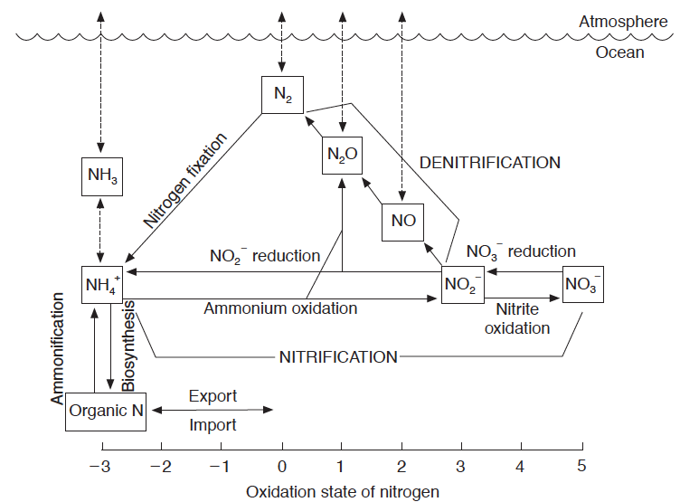
NH₄⁺ vs NO₃⁻ assimilation
Karl and Michaels 2001

Slide 9
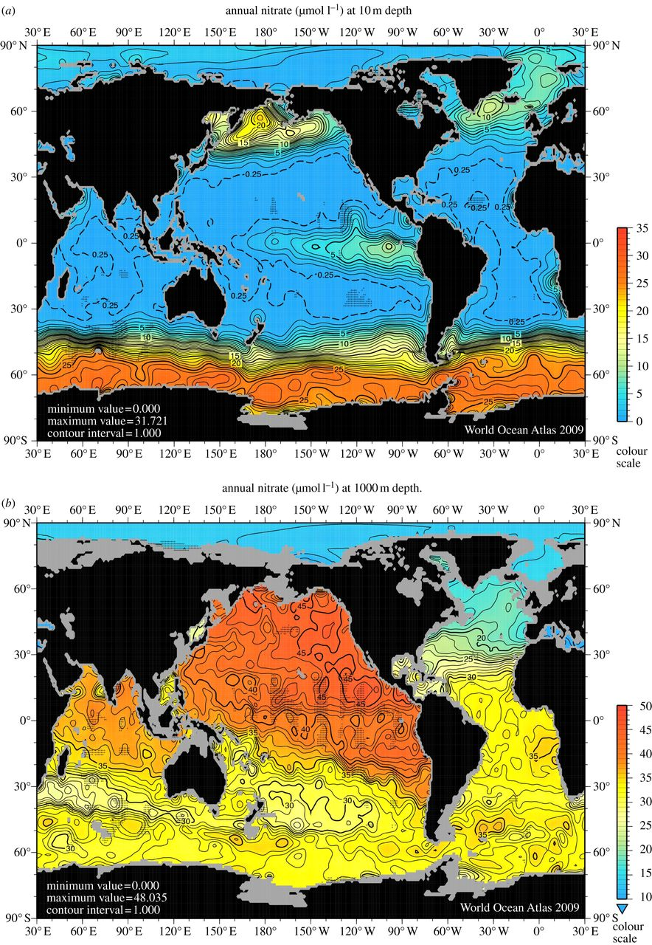
Annual average surface [NO₃⁻] (μM)
Annual average 1000 m [NO₃⁻] (μM)
Boyer et al. 2006

Slide 10
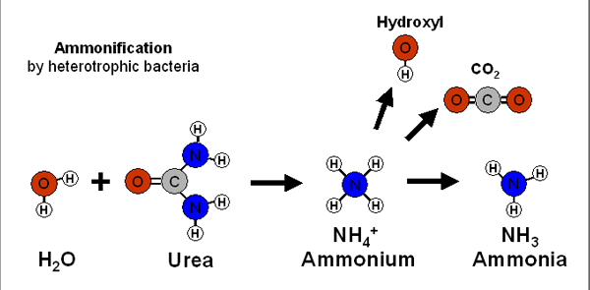
Internal cycle – remineralization
Ammonification: N_{org} → NH₄⁺ (heterotrophic bacteria)
(2) Nitrification: NH₄⁺ → NO₂⁻ → NO₃⁻ (chemoautotrophic)
+ (2) = remineralization
C₁₀₆H₁₇₅O₄₂N₁₆P + 150O₂ → 106CO₂ + 16NO₃⁻ + HPO₄²⁻ + 78H₂O + 18H⁺

Slide 11
Internal cycle – nitrification
Ammonium oxidation: NH₄⁺ → NO₂⁻
Nitrite oxidation: NO₂⁻ → NO₃⁻
Two processes facilitated by different organisms (ammonium oxidizing archaea and bacteria, nitrite oxidizing bacteria)

Slide 12
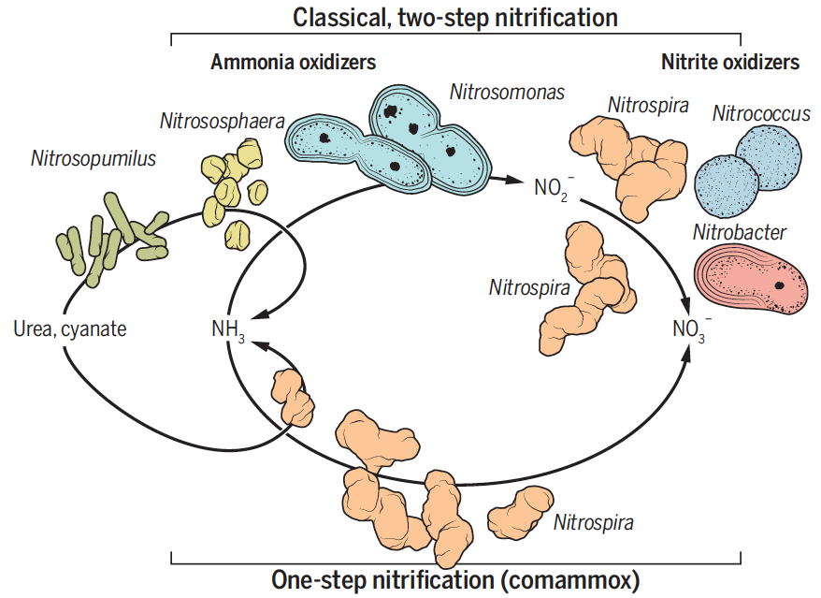
Internal cycle – nitrification
Ammonium oxidation: NH₄⁺ → NO₂⁻
Nitrite oxidation: NO₂⁻ → NO₃⁻
Two processes facilitated by different organisms (ammonium oxidizing archaea and bacteria, nitrite oxidizing bacteria)
Santoro 2015

Slide 13
Internal cycle – nitrification
Ammonium oxidation: NH₄⁺ → NO₂⁻
Nitrite oxidation: NO₂⁻ → NO₃⁻
Two processes facilitated by different organisms (ammonium oxidizing archaea and bacteria, nitrite oxidizing bacteria)
Chemoautotrophic process: energy yielding
Thought to be light-inhibited; competition with phytoplankton for NH₄⁺ (require 8-42 mols of N to fix 1 mol of C vs. 0.15 mols of N for phytoplankton) → vertical separation of assimilation and nitrification

Slide 14
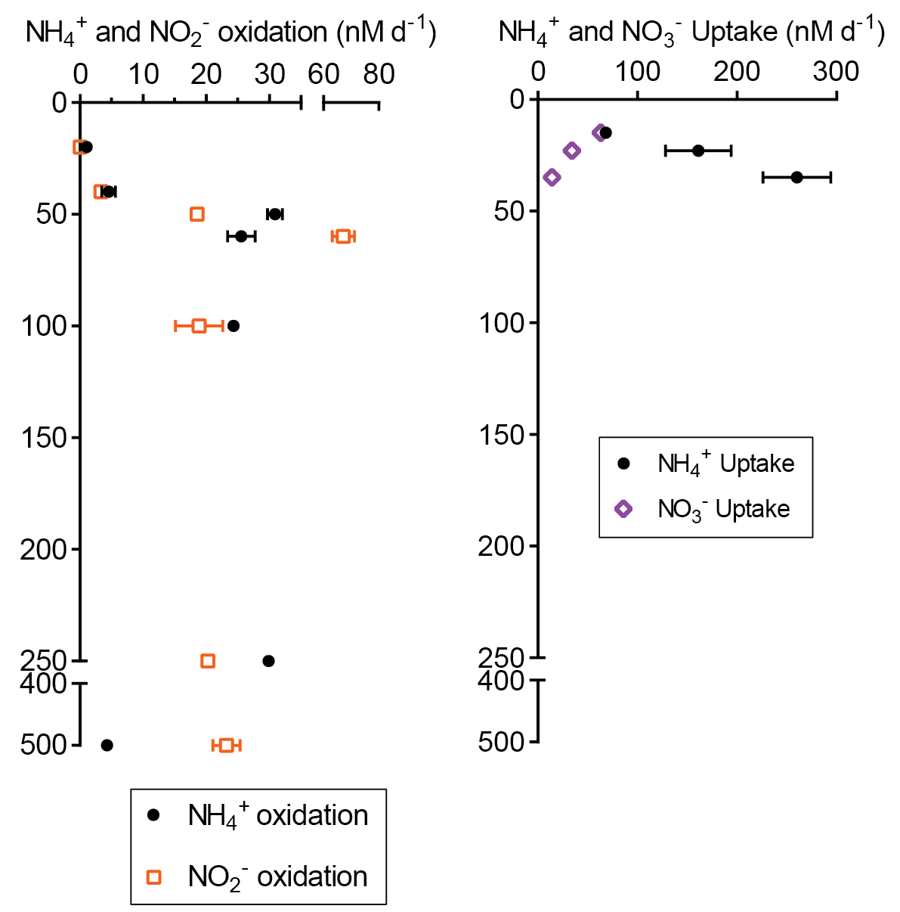
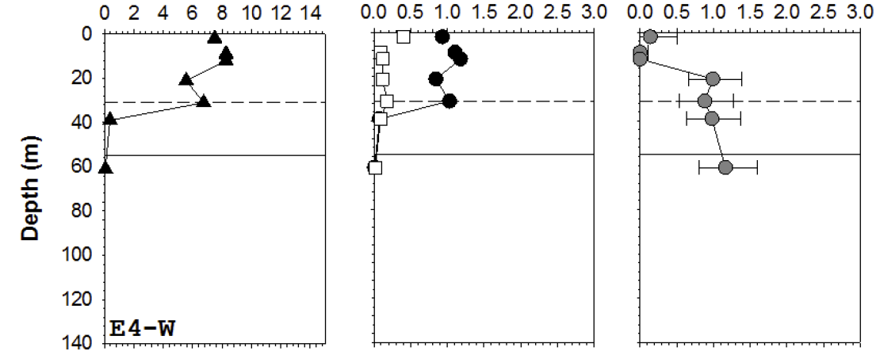
Internal cycle – nitrification
Subarctic North Atlantic
Southern Ocean
nitrification
assimilation
nitrification
assimilation
NO₂⁻ oxidation (μM d⁻¹)
N uptake (μM d⁻¹)
MLD
euphotic zone
MLD
NO₂⁻ oxidation
NH₄⁺ uptake
NO₃⁻ uptake
Peng et al. in prep; Cavagna et al. 2015

Slide 15
The marine nitrogen (N) cycle
Input/output budget is largely biologically controlled
Exists in numerous forms/oxidation states (“bioavailability”)
Oceanic residence time of ~3000 years
N₂ fixation: N_{2(gas)} → NH₄⁺ (major input)
Denitrification: NO₃⁻ → NO₂⁻ → NO_{(gas)} → N₂O_{(gas)} → N_{2(gas)} (major loss process)
N assimilation: NH₄⁺, NO₃⁻, NO₂⁻, DON directly taken up by phytoplankton and synthesized into biomass (N_{org}/PON)
Ammonification: N_{org} → NH₄⁺ (heterotrophic bacteria)
Nitrification: NH₄⁺ → NO₂⁻ → NO₃⁻ (chemoautotrophic)
Internal cycle
remineralization

Slide 16
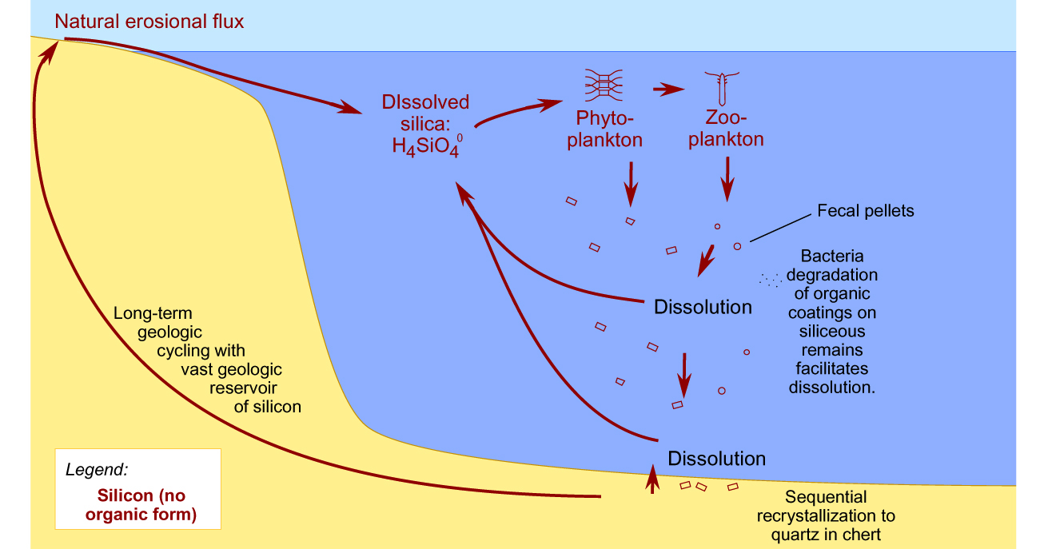
The marine silica (Si) cycle
Biogenic silica
Lithogenic
silica
Dissolved
silica Si(OH)₄
Dissolution rather than oxidative remineralization returns Si to a usable form (no organic form)

Slide 17
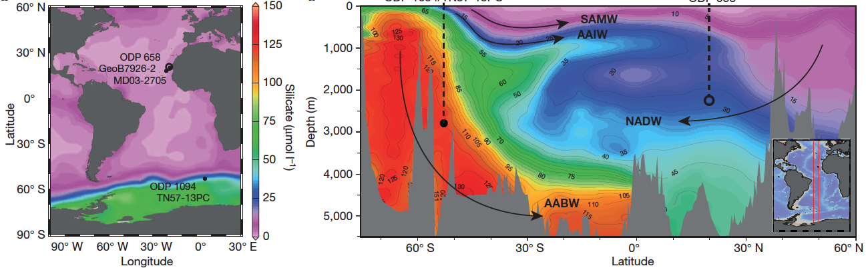
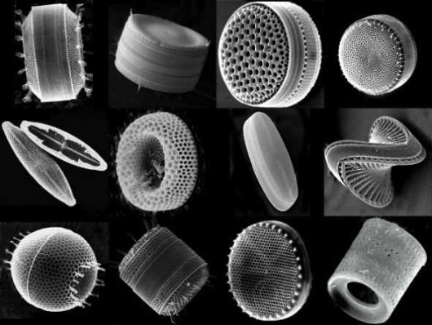
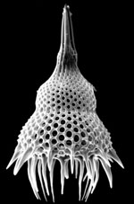
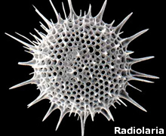
The marine silica (Si) cycle
diatoms (phytoplankton)
radiolaria (zooplankton)
Meckler et al. 2013

Slide 18
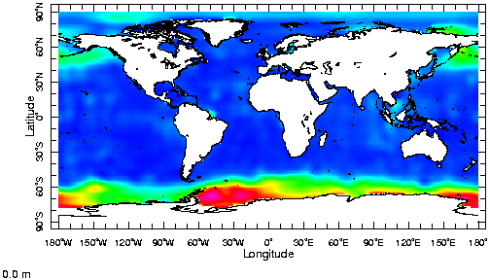
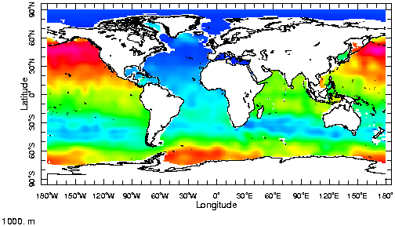
Dissolved silica concentrations
surface
1000 m

Slide 19
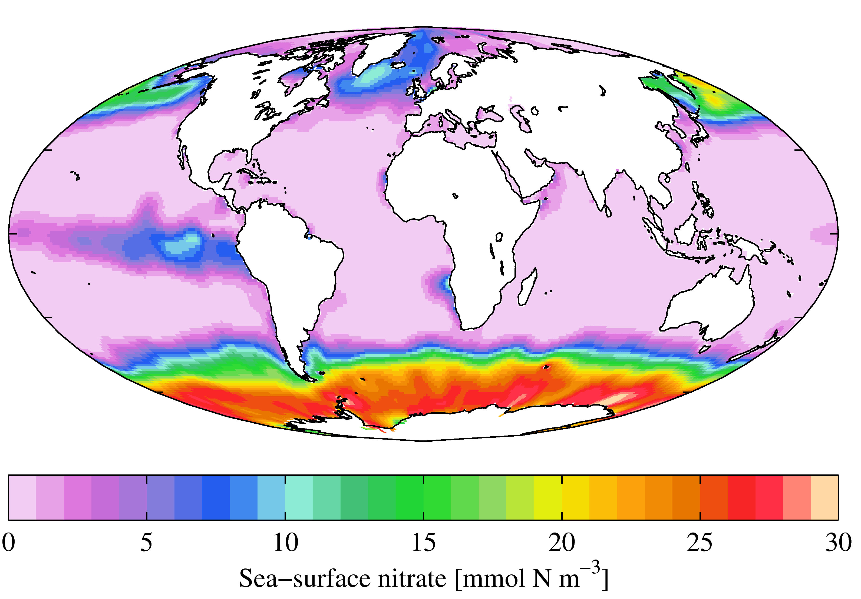
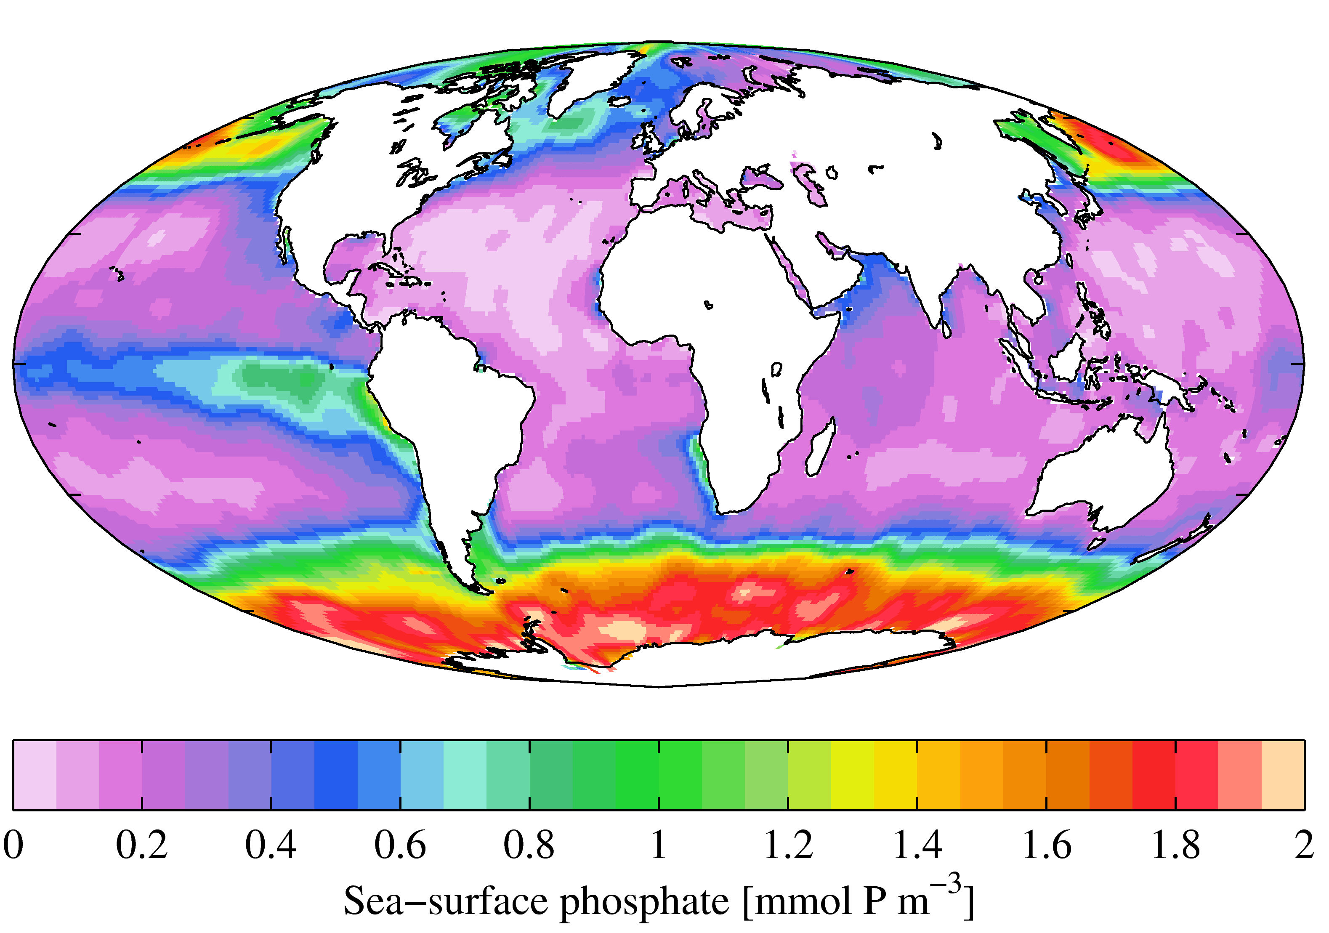
Surface [NO₃⁻] (μM)
Surface [PO₄³⁻] (μM)

Slide 20
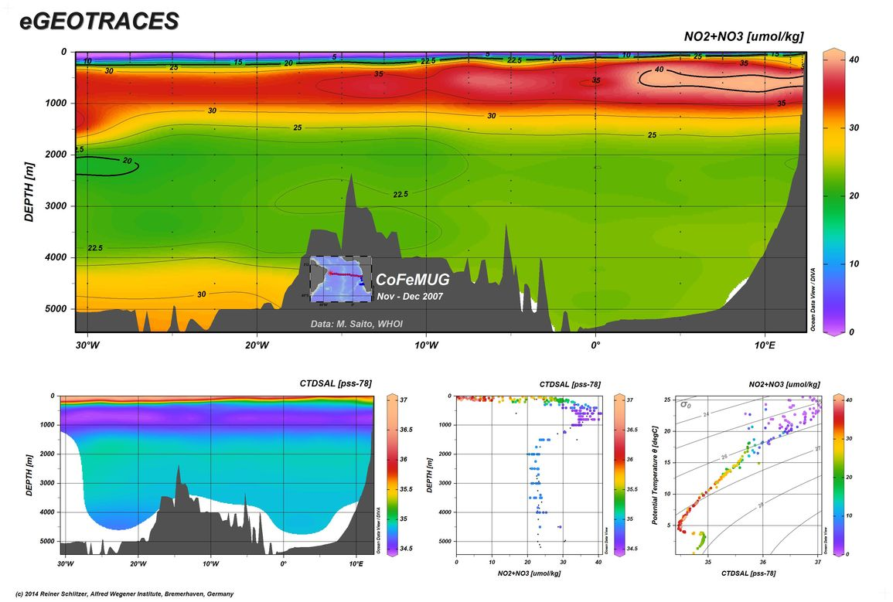
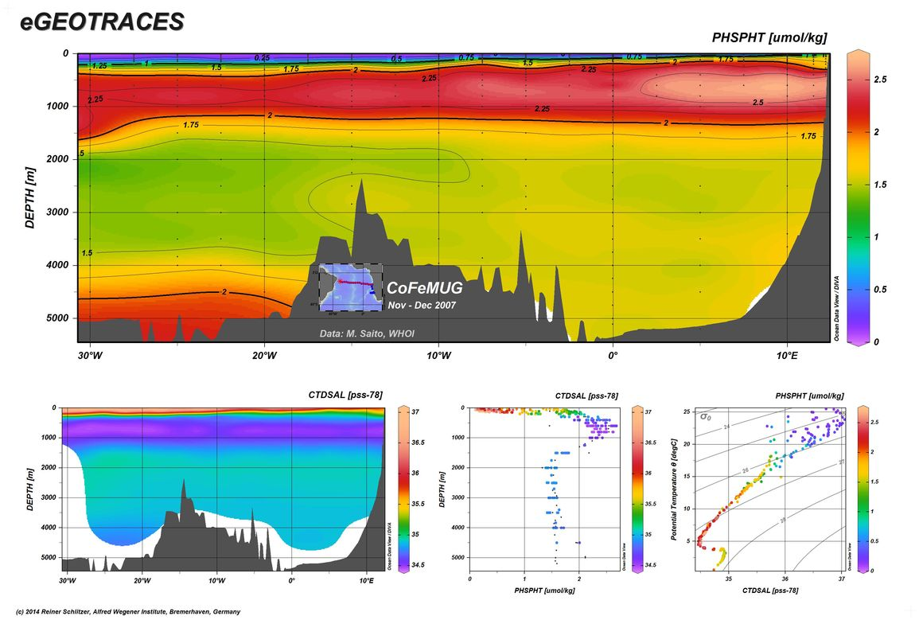
0
40
1000
30
2000
3000
20
4000
10
[NO₃⁻] (μmol/kg)
5000
0
30°W
20°W
10°W
0°
10°E
0
2.5
1000
2.0
2000
1.5
3000
1.0
4000
[PO₄³⁻] (μmol/kg)
0.5
5000
0
30°W
20°W
10°W
0°
10°E
http://www.egeotraces.org/

Slide 21
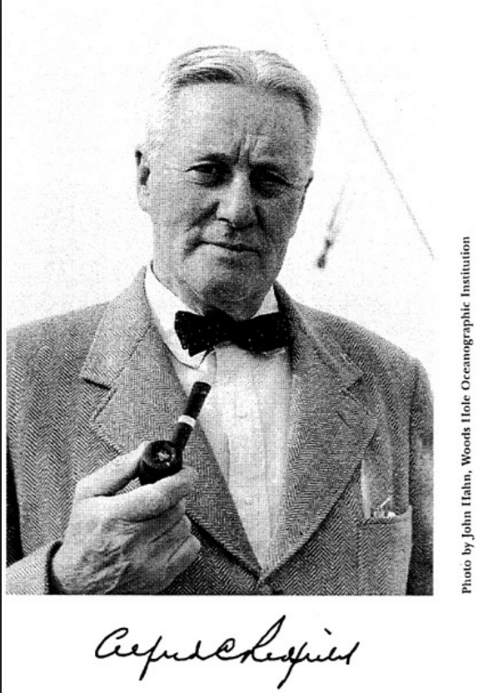
The Redfield ratio
C : N : P
106 : 16 : 1
Redfield A.C. (1934) On the proportions of organic derivatives in seawater and their relation to the composition of plankton. In James Johnson Memorial Volume (Ed. R.J. Daniel). University Press of Liverpool, pp. 177-192.

Slide 22
The Redfield ratio
source:
1) atmosphere
source:
1) geological/fluvial
C : N : P
source:
1) N₂ fixation
2) ocean subsurface
3) remineralization of OM
4) biological excretions
5) atmospheric N

Slide 23
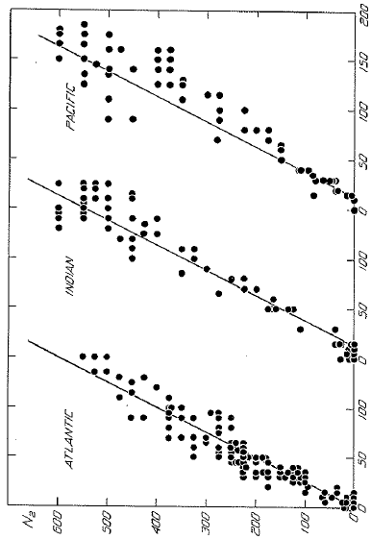
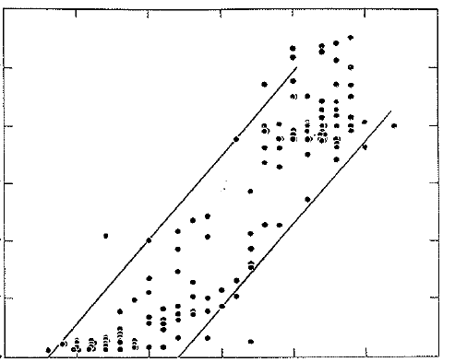
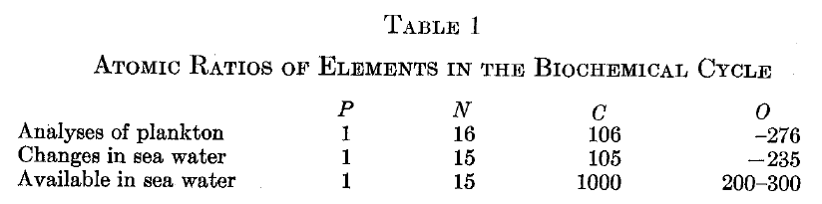
The Redfield ratio
ΔN:ΔP = 15-20:1
Atlantic
ΔN:ΔC = 15:106
Indian
Nitrate
Pacific
Phosphate
Carbon
Redfield 1934, 1958

Slide 24
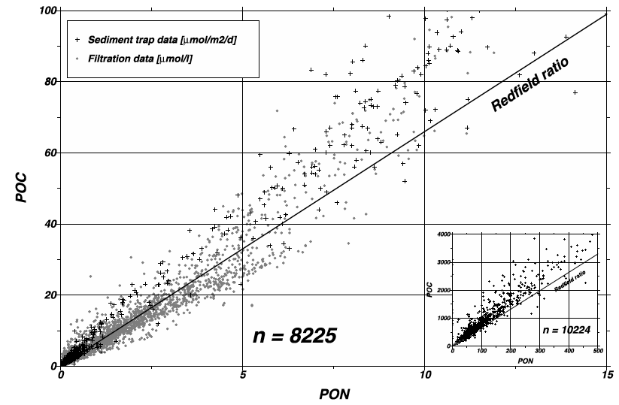
The Redfield ratio: biomass
Sinking and suspended
organic matter
ΔC:ΔN = 106:16 = 6.6:1
Particulate organic carbon (C)
Particulate organic nitrogen (N)
Schneider et al. 2003

Slide 25
The Redfield ratio: biomass
Average elemental/molar ratio of phytoplankton
106 CO₂ + 16 HNO₃ + H₃PO₄ + 78 H₂O ↔
(C₁₀₆H₁₇₅O₄₂N₁₆P) + 150 O₂
Remineralization: O₂:C_{org}:N:P ≈ -150:106:16:1
Remineralization: -O₂:C_{org}:N:P ≈ 150:106:16:1
Example: if PO₄³⁻ is observed to decrease by
0.5 μM due to phytoplankton growth, then nitrate is likely to have decreased by (0.5 x 16) = 8 μM

Slide 26
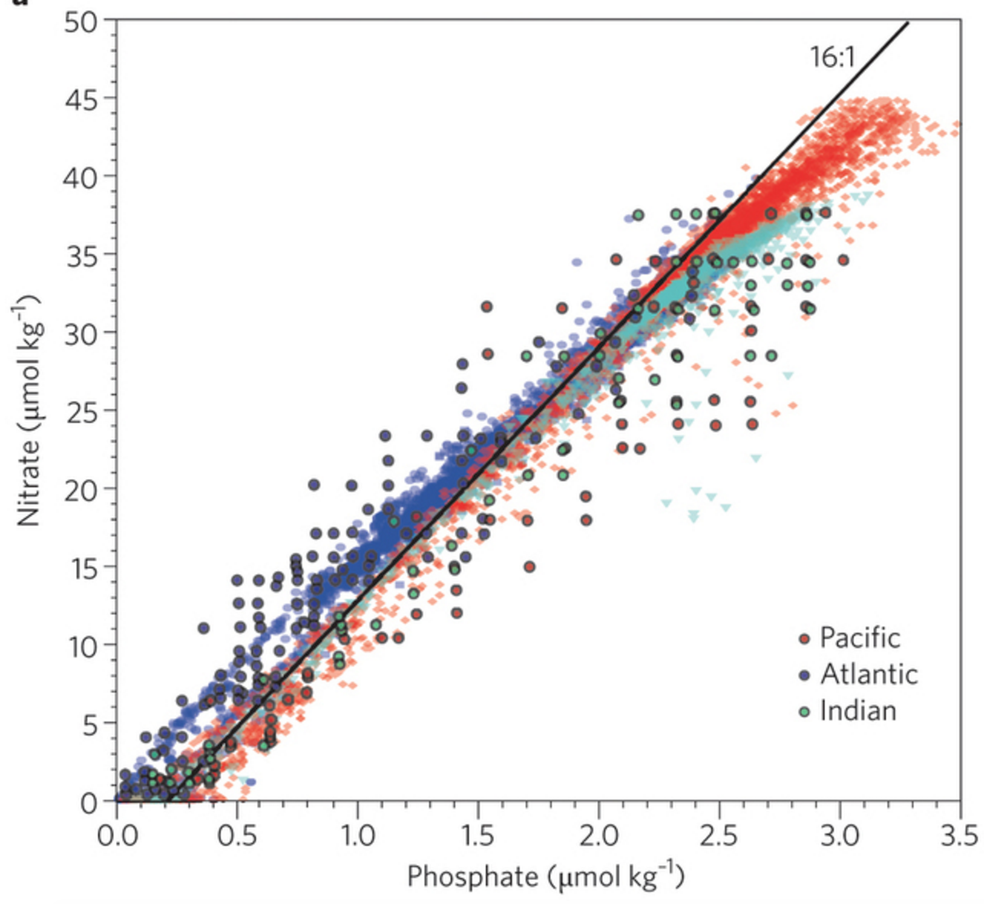
The Redfield ratio: nutrients
Gruber and Deutsch 2014

Slide 27
Why is the Redfield ratio useful?
Average elemental/molar ratio of phytoplankton
106 CO₂ + 16 HNO₃ + H₃PO₄ + 78 H₂O ↔
(C₁₀₆H₁₇₅O₄₂N₁₆P) + 150 O₂
Remineralization: -O₂:C_{org}:N:P ≈ 150:106:16:1
Example 1: if PO₄³⁻ is observed to decrease by
0.5 μM due to phytoplankton growth, then NO₃⁻ is likely to have decreased by ??

Slide 28
Why is the Redfield ratio useful?
Average elemental/molar ratio of phytoplankton
106 CO₂ + 16 HNO₃ + H₃PO₄ + 78 H₂O ↔
(C₁₀₆H₁₇₅O₄₂N₁₆P) + 150 O₂
Remineralization: -O₂:C_{org}:N:P ≈ 150:106:16:1
Example 1: if PO₄³⁻ is observed to decrease by
0.5 μM due to phytoplankton growth, then NO₃⁻ is likely to have decreased by (0.5 x 16) = 8 μM

Slide 29
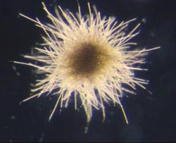
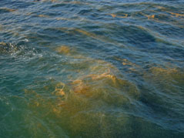
Deviations from Redfield stoichiometry
N₂ fixation
N₂ + 8 H⁺ + 8 e⁻ + 16 ATP → 2 NH₃ + H₂ + 16 ADP + 16 Pi
Generates ‘fixed N’ from unavailable N₂
Requires PO₄³⁻
Denitrification
C₁₀₆H₁₇₅O₄₂N₁₆P + 94.4 HNO₃ → 106 CO₂ + 55.2 N₂ + H₃PO₄ + 177.2 H₂O
Removes nitrate from the ocean as N₂ gas
Converts organic P to PO₄³⁻

Slide 30
Deviations from Redfield stoichiometry
N₂ fixation
N₂ + 8 H⁺ + 8 e⁻ + 16 ATP → 2 NH₃ + H₂ + 16 ADP + 16 Pi
Generates ‘fixed N’ from unavailable N₂
Requires PO₄³⁻
Denitrification
C₁₀₆H₁₇₅O₄₂N₁₆P + 94.4 HNO₃ → 106 CO₂ + 55.2 N₂ + H₃PO₄ + 177.2 H₂O
Removes nitrate from the ocean as N₂ gas
Converts organic P to PO₄³⁻
N:P ⬆

Slide 31
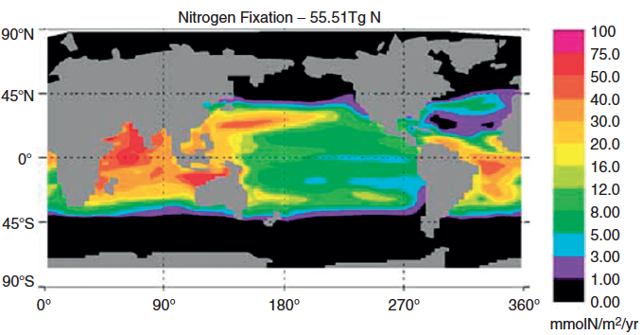
Input: N₂ fixation N₂(gas) → NH₄⁺
Moore et al. 2004

Slide 32
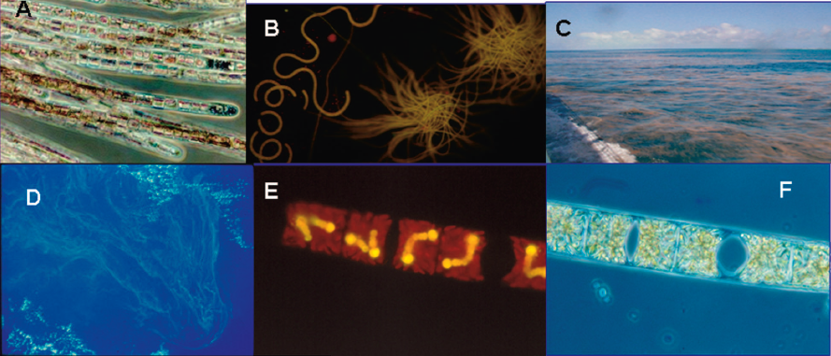
Input: N₂ fixation N₂(gas) → NH₄⁺
Trichodesmium spp. and DDAs

Slide 33
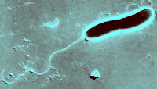
Deviations from Redfield stoichiometry
N₂ fixation
N₂ + 8 H⁺ + 8 e⁻ + 16 ATP → 2 NH₃ + H₂ + 16 ADP + 16 Pi
Generates ‘fixed N’ from unavailable N₂
Requires PO₄³⁻
Denitrification
C₁₀₆H₁₇₅O₄₂N₁₆P + 94.4 HNO₃ → 106 CO₂ + 55.2 N₂ + H₃PO₄ + 177.2 H₂O
Removes nitrate from the ocean as N₂ gas
Converts organic P to PO₄³⁻
N:P ⬆

Slide 34
Deviations from Redfield stoichiometry
N₂ fixation
N₂ + 8 H⁺ + 8 e⁻ + 16 ATP → 2 NH₃ + H₂ + 16 ADP + 16 Pi
Generates ‘fixed N’ from unavailable N₂
Requires PO₄³⁻
Denitrification
C₁₀₆H₁₇₅O₄₂N₁₆P + 94.4 HNO₃ → 106 CO₂ + 55.2 N₂ + H₃PO₄ + 177.2 H₂O
Removes nitrate from the ocean as N₂ gas
Converts organic P to PO₄³⁻
N:P ⬆
N:P ⬇

Slide 35
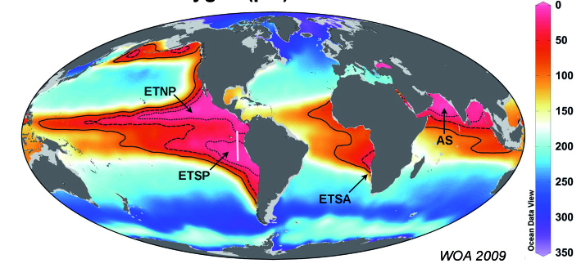
Output: Denitrification NO₃⁻ → N₂(gas)
[O₂] at 200 m (μmol/kg)
Major oxygen deficient zones (ODZ): ETNP, ETSP, Arabian Sea

Slide 36
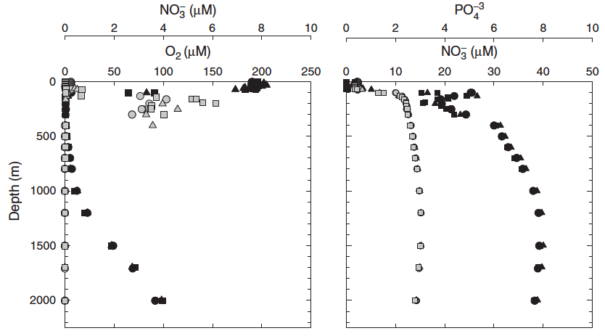
Output: Denitrification NO₃⁻ → N₂(gas)
Arabian Sea
[NO₃⁻]
[PO₄³⁻]
Devol 2008

Slide 37
Output: Denitrification NO₃⁻ → N₂(gas)
Arabian Sea
[NO₃⁻]
[PO₄³⁻]
Devol 2008

Slide 38
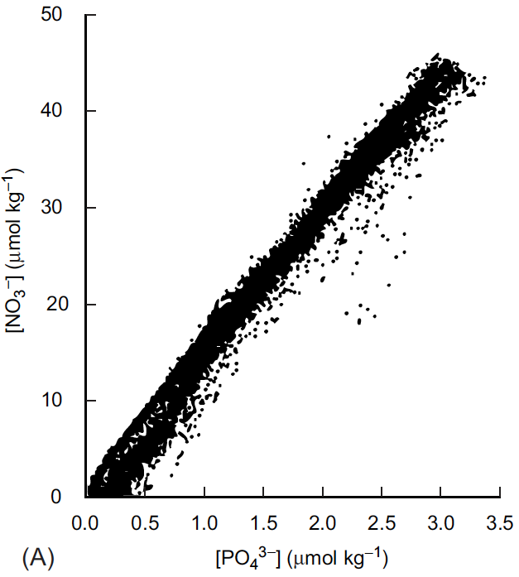
Deviations from Redfield stoichiometry

Slide 39
Deviations from Redfield stoichiometry
Upwelling followed by nutrient uptake with a 16:1 N:P ratio

Slide 40
Deviations from Redfield stoichiometry
Upwelling followed by nutrient uptake with a 16:1 N:P ratio
Excess P is consumed in the surface by N₂ fixation; N:P rises

Slide 41
Deviations from Redfield stoichiometry
Respiration of sinking OM raises NO₃⁻:PO₄³⁻ in a 16:1 ratio
Upwelling followed by nutrient uptake with a 16:1 N:P ratio
Excess P is consumed in the surface by N₂ fixation; N:P rises

Slide 42
Deviations from Redfield stoichiometry
Respiration of sinking OM raises NO₃⁻:PO₄³⁻ in a 16:1 ratio
N loss (denitrification)
in low O₂ waters and sediments decrease N and raises P
Upwelling followed by nutrient uptake with a 16:1 N:P ratio
Excess P is consumed in the surface by N₂ fixation; N:P rises

Slide 43
Deviations from Redfield stoichiometry
N₂ fixation
denitrification

Slide 44
Deviations from Redfield stoichiometry
106 CO₂ + 16 HNO₃ + H₃PO₄ + 78 H₂O ↔
(C₁₀₆H₁₇₅O₄₂N₁₆P) + 150 O₂
Remineralization: O₂:C_{org}:N:P ≈ -150:106:16:1
Example 2: if remineralization of organic matter is observed to draw down 10 μM O₂, then DIC should increase by (10 x 106/150) ≈ 7.1 μM and NO₃⁻ should increase by (10 x 16/150) ≈ 1.1 μM
Also applies to oxygen

Slide 45
Apparent oxygen utilization (AOU)
The O₂ distribution in the ocean is a result of:
surface equilibration with atmospheric O₂
biological production due to photosynthesis
biological use of O₂ during respiration and remineralization
increase in deep water O₂ due to sinking of cold, O₂-rich waters
To more easily interpret the physical and biological effects on O₂, we consider the amount that is utilized rather than the total O₂ concentration:
AOU (μmol/L) = [O₂]_{calc} – [O₂]_{meas}
[O₂]_{calc} = predicted [O₂] at given temperature and salinity

Slide 46
Apparent oxygen utilization (AOU)
The O₂ distribution in the ocean is a result of:
surface equilibration with atmospheric O₂
biological production due to photosynthesis
biological use of O₂ during respiration and remineralization
increase in deep water O₂ due to sinking of cold, O₂-rich waters
To more easily interpret the physical and biological effects on O₂, we consider the amount that is utilized rather than the total O₂ concentration:
AOU (μmol/L) = [O₂]_{sat} – [O₂]_{meas}
[O₂]_{sat} = predicted [O₂] at given temperature and salinity

Slide 47
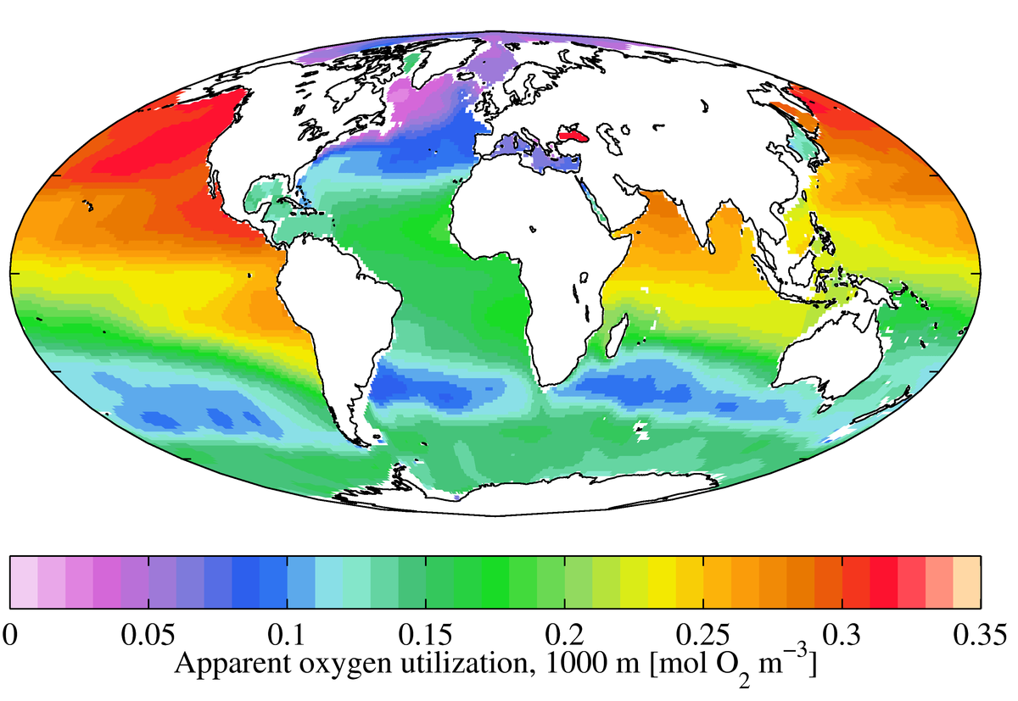
AOU at 1000 m

Slide 48
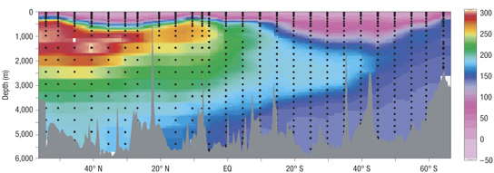
Apparent oxygen utilization (AOU)
AOU
μmol/kg
Pacific Ocean

Slide 49
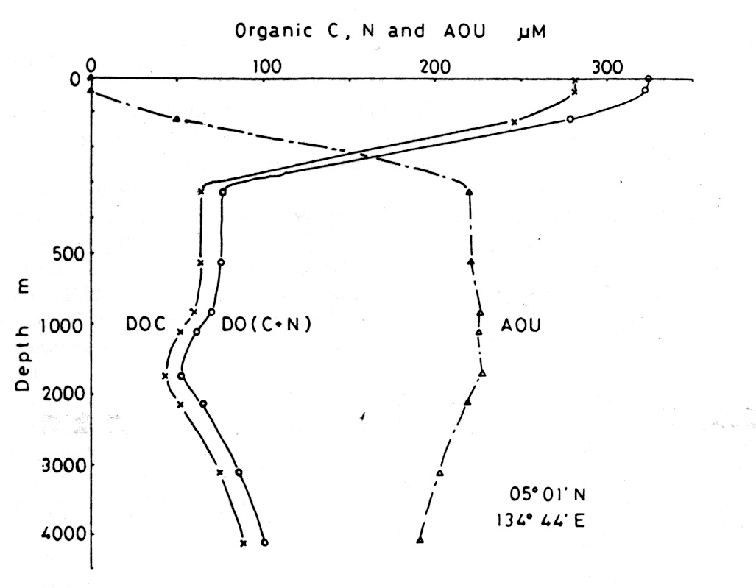
Apparent oxygen utilization (AOU)
AOU
Particulate organic carbon
Remineralization: AOU:C_{org}:N:P ≈ 150:106:16:1

Slide 50
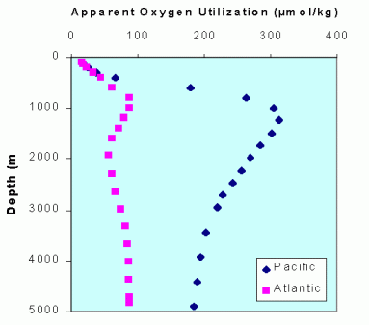
Apparent oxygen utilization (AOU)

